Slide 1

TCP/ IP PROTOCOL STACK

Slide 2

Describes a set of general design guidelines and implementations of specific networking protocols to enable computers to communicate over a network.
Provides end-to-end connectivity specifying how data should be formatted, addressed, transmitted, routed and received at the destination.
Protocols exist for a variety of different types of communication services between computers.

Slide 3
Key Requirements
It must be completely decentralized with no key central installation that could be destroyed and bring down the whole network.
It must be fully redundant and able to continue communication between A and B even though intermediate sites and links might stop functioning during the conversation.
The architecture must be flexible as the envisaged range of applications for the network was wide: from file transfer to time sensitive data such as voice.

Slide 4

Design Goals:
Hardware independence - A protocol suite that could be used on a Mac, PC, mainframe, or any other computer.
Software independence - A protocol suite that could be used by different software vendors and applications. This would enable a host on one site to communicate with a host on another site, without having the same software configuration: heterogeneous networks.
Failure recovery and the ability to handle high error rates - A protocol suite that featured automatic recovery from any dropped or lost data. This protocol must be able to recover from an outage of any host on any part of the network and at any point in a data transfer.

Slide 5
Design Goals:
Efficient protocol with low overhead - A protocol suite that had a minimal amount of “extra” data moving with the data being transferred.
  This extra data called overhead, functions as packaging for the data being transferred and enables the data transmission.
Ability to add new networks to the internetwork without service disruption - A protocol suite that enable new, independent networks to join this network of networks without bringing down the larger internetwork.

Slide 6
Design Goals:
Routable Data - A protocol suite on which data could make its way through an internetwork of computers to any possible destination.
  For this to be possible, a single and meaningful addressing scheme must be used
  Every computer that is moving the data should be able to compute the best path for every piece of data as it moves through the network.

Slide 7
Was developed before the OSI model was published.
Unlike the OSI model, the TCP/IP model has four layers. Still, it answers the same questions about network communications as the OSI model.
An early architectural document, RFC 1122, emphasizes architectural principles over layering.

Slide 8
Protocol Layers
End-to-End Principle: Evolved over time.
Originally it has put the maintenance of state and overall intelligence at the edges, and assumed the Internet that connected the edges retained no state and concentrated on speed and simplicity.
Real-world needs for firewalls, network address translators, web content caches etc. have forced changes in this principle.

Slide 9
Protocol Layers
Robustness Principle: "In general, an implementation must be conservative in its sending behavior, and liberal in its receiving behavior.
That is, it must be careful to send well-formed datagrams, but must accept any datagram that it can interpret (e.g., not object to technical errors where the meaning is still clear) RFC 791.”

Slide 10

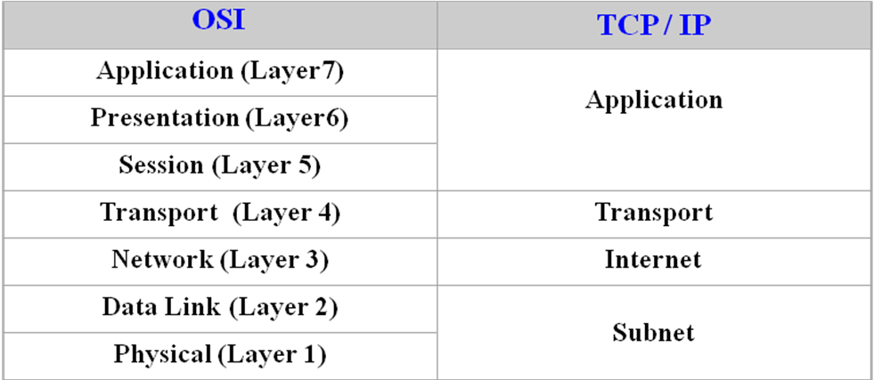
Pretty similar to OSI
TCP/IP has less layers(four)
Main difference in layers is after layer 4

Slide 11
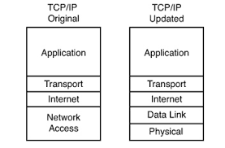

Slide 12
Protocol Layers
RFC 1122. It defines a four-layer model, with the layers having names, not numbers, as follows:
Application (process-to-process) Layer: This is the scope within which applications create user data and communicate this data to other processes or applications on another or the same host. The communications partners are often called peers. This is where the "higher level" protocols such as SMTP, FTP, SSH, HTTP, etc. operate.

Slide 13
Transport (host-to-host) Layer: The Transport Layer constitutes the networking regime between two network hosts, either on the local network or on remote networks separated by routers.
The Transport Layer provides a uniform networking interface that hides the actual topology (layout) of the underlying network connections.
This is where flow-control, error-correction, and connection protocols exist, such as TCP. This layer deals with opening and maintaining connections between Internet hosts.

Slide 14
Internet (internetworking) Layer: The Internet Layer has the task of exchanging datagrams across network boundaries. It is therefore also referred to as the layer that establishes internetworking
This layer defines the addressing and routing structures used for the TCP/IP protocol suite.
The primary protocol in this scope is the Internet Protocol, which defines IP addresses.
Its function in routing is to transport datagrams to the next IP router that has the connectivity to a network closer to the final data destination.

Slide 15
Link Layer: This layer defines the networking methods with the scope of the local network link on which hosts communicate without intervening routers.
This layer describes the protocols used to describe the local network topology and the interfaces needed to affect transmission of Internet Layer datagrams to next-neighbor hosts.

Slide 16
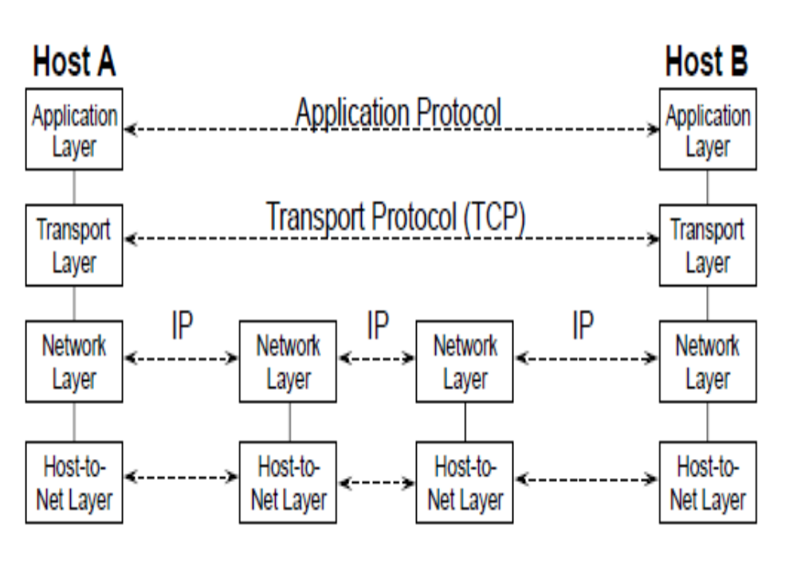

Slide 17
Data encapsulation - During a transmission, data crosses each of the layers at the source machine.
At each layer, a piece of information is added to the data packet, this is the header, a collection of information which guarantees transmission.
At the destination machine, when passing through each layer, the header is read, and then deleted. So, upon its receipt, the message is in its original state.

Slide 18
At each level, the data packet changes aspect, because a header is added to it
The data packet is called a message at Application Layer
The message is then encapsulated in the form of a segment in the Transport Layer
Once the segment is encapsulated in the Internet Layer it takes the name of datagram
Finally, we talk about a frame at the Link Layer

Slide 19
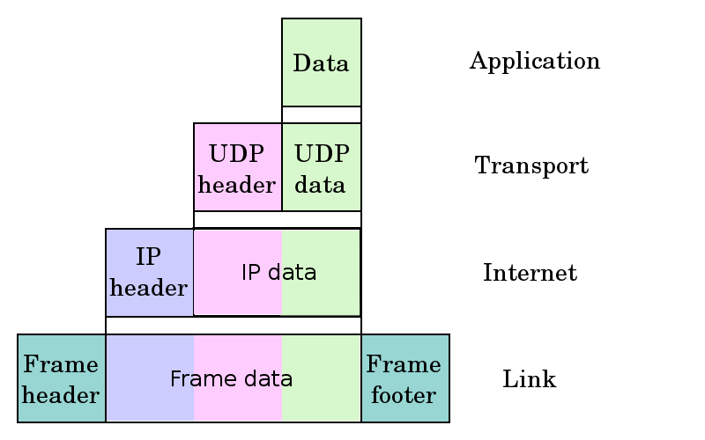

Slide 20
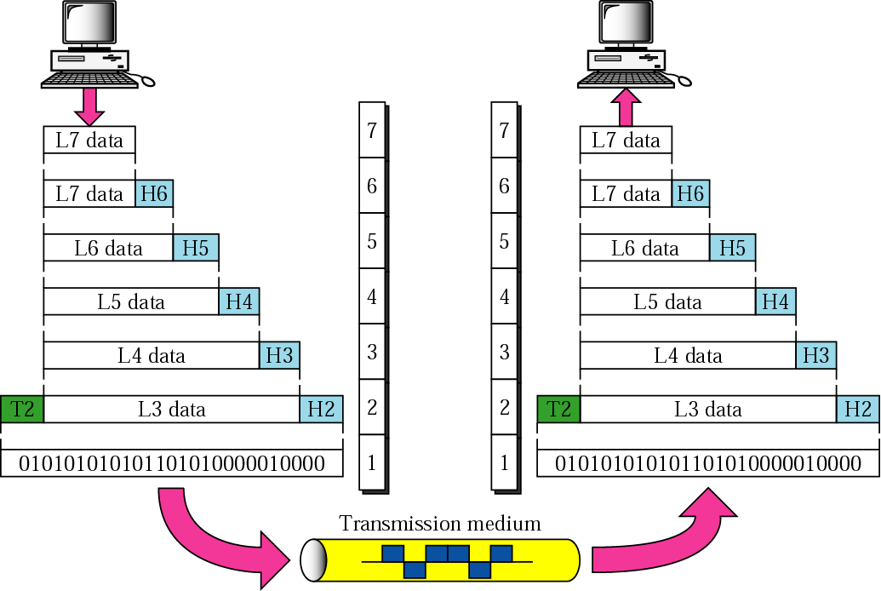
Protocol Reference Model of OSI
OSI Overview
4. Data Encapsulation
a) PDU conception – each protocol on the diff. layer has its own format.
b) Headers are added while a packet is going down the stack at each layer.
c) Trailers are usually added on the second layer.

Slide 21

TC/IP becomes a standard
A standard for software
A standard for hardware
Four layers architecture
Each layer independent on the others

